Slide 1
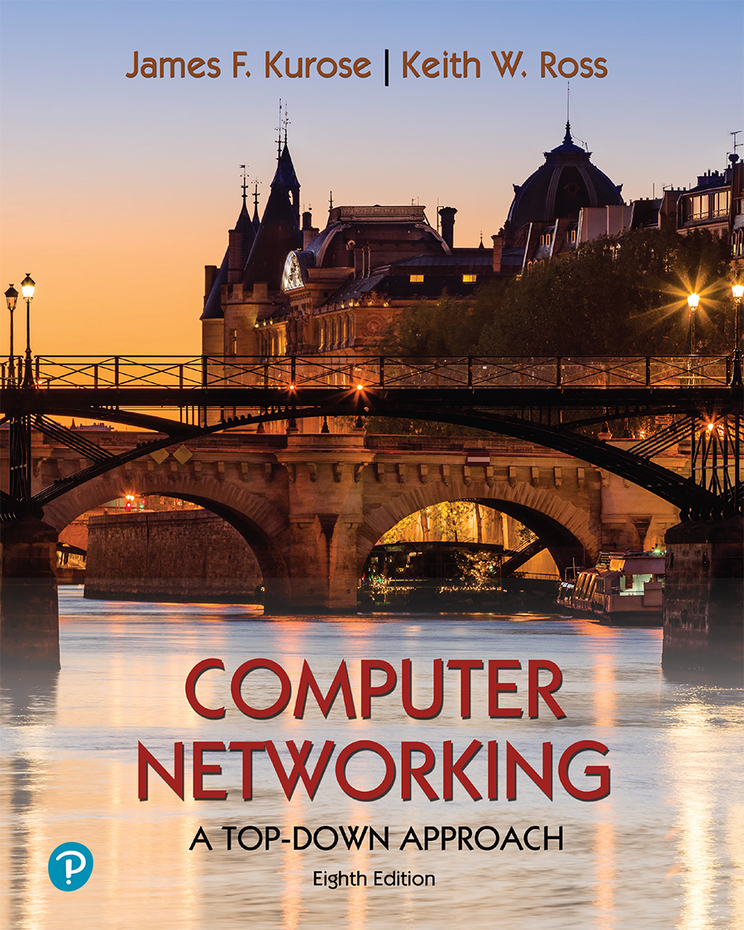
Chapter 8 Security
A note on the use of these PowerPoint slides:
We’re making these slides freely available to all (faculty, students, readers). They’re in PowerPoint form so you see the animations; and can add, modify, and delete slides (including this one) and slide content to suit your needs. They obviously represent a lot of work on our part. In return for use, we only ask the following:
If you use these slides (e.g., in a class) that you mention their source (after all, we’d like people to use our book!)
If you post any slides on a www site, that you note that they are adapted from (or perhaps identical to) our slides, and note our copyright of this material.
For a revision history, see the slide note for this page.
Thanks and enjoy! JFK/KWR
All material copyright 1996-2023
J.F Kurose and K.W. Ross, All Rights Reserved
Computer Networking: A Top-Down Approach 8th edition Jim Kurose, Keith Ross Pearson, 2020
Notes:
Version History
8.0 (May 2020)
All slides reformatted for 16:9 aspect ratio
All slides updated to 8th edition material
Use of Calibri font, rather that Gill Sans MT
Add LOTS more animation throughout
lighter header font
wireless security completely redone (updated WiFi and added 4G/5G)
SSL material replaces by TLS 1.3 (up-to-date)
V8.2 (Feb 2022)
Minor corrections

Slide 2

Chapter 8 outline
What is network security?
Principles of cryptography
Authentication, message integrity
Securing e-mail
Securing TCP connections: TLS
Network layer security: IPsec
Security in wireless and mobile networks
Operational security: firewalls and IDS

Slide 3

Firewalls
firewall
isolates organization’s internal network from larger Internet, allowing some packets to pass, blocking others
administered
network
public
Internet
trusted “good guys”
untrusted “bad guys”
firewall

Slide 4
Firewalls: why
prevent denial of service attacks:
SYN flooding: attacker establishes many bogus TCP connections, no resources left for “real” connections
prevent illegal modification/access of internal data
e.g., attacker replaces CIA’s homepage with something else
allow only authorized access to inside network
set of authenticated users/hosts
three types of firewalls:
stateless packet filters
stateful packet filters
application gateways

Slide 5
Stateless packet filtering
Should arriving packet be allowed in? Departing packet let out?
internal network connected to Internet via router firewall
filters packet-by-packet, decision to forward/drop packet based on:
source IP address, destination IP address
TCP/UDP source, destination port numbers
ICMP message type
TCP SYN, ACK bits

Slide 6
Stateless packet filtering: example
Should arriving packet be allowed in? Departing packet let out?
example 1: block incoming and outgoing datagrams with IP protocol field = 17 and with either source or dest port = 23
result: all incoming, outgoing UDP flows and telnet connections are blocked
example 2: block inbound TCP segments with ACK=0
result: prevents external clients from making TCP connections with internal clients, but allows internal clients to connect to outside

Slide 7
Stateless packet filtering: more examples
Policy | Firewall Setting
no outside Web access | drop all outgoing packets to any IP address, port 80
no incoming TCP connections, except those for institution’s public Web server only. | drop all incoming TCP SYN packets to any IP except 130.207.244.203, port 80
prevent Web-radios from eating up the available bandwidth. | drop all incoming UDP packets - except DNS and router broadcasts.
prevent your network from being used for a smurf DoS attack. | drop all ICMP packets going to a “broadcast” address (e.g. 130.207.255.255)
prevent your network from being tracerouted | drop all outgoing ICMP TTL expired traffic

Slide 8
Access Control Lists
ACL: table of rules, applied top to bottom to incoming packets: (action, condition) pairs: looks like OpenFlow forwarding (Ch. 4)!
action | source address | dest address | protocol | source port | dest port | flag bit
allow | 222.22/16 | outside of 222.22/16 | TCP | > 1023 | 80 | any
allow | outside of 222.22/16 | 222.22/16 | TCP | 80 | > 1023 | ACK
allow | 222.22/16 | outside of 222.22/16 | UDP | > 1023 | 53 | ---
allow | outside of 222.22/16 | 222.22/16 | UDP | 53 | > 1023 | ----
deny | all | all | all | all | all | all

Slide 9
Stateful packet filtering
stateless packet filter: heavy handed tool
admits packets that “make no sense,” e.g., dest port = 80, ACK bit set, even though no TCP connection established:
action | source address | dest address | protocol | source port | dest port | flag bit
allow | outside of 222.22/16 | 222.22/16 | TCP | 80 | > 1023 | ACK
stateful packet filter: track status of every TCP connection
track connection setup (SYN), teardown (FIN): determine whether incoming, outgoing packets “makes sense”
timeout inactive connections at firewall: no longer admit packets

Slide 10
Stateful packet filtering
ACL augmented to indicate need to check connection state table before admitting packet
action | source address | dest address | proto | source port | dest port | flag bit | check connection
allow | 222.22/16 | outside of 222.22/16 | TCP | > 1023 | 80 | any
allow | outside of 222.22/16 | 222.22/16 | TCP | 80 | > 1023 | ACK | x
allow | 222.22/16 | outside of 222.22/16 | UDP | > 1023 | 53 | ---
allow | outside of 222.22/16 | 222.22/16 | UDP | 53 | > 1023 | ---- | x
deny | all | all | all | all | all | all

Slide 11
Application gateways
filter packets on application data as well as on IP/TCP/UDP fields.
example: allow select internal users to telnet outside
host-to-gateway
telnet session
application
gateway
router and filter
gateway-to-remote
host telnet session
1. require all telnet users to telnet through gateway.
2. for authorized users, gateway sets up telnet connection to dest host
gateway relays data between 2 connections
3. router filter blocks all telnet connections not originating from gateway

Slide 12
Limitations of firewalls, gateways
IP spoofing: router can’t know if data “really” comes from claimed source
if multiple apps need special treatment, each has own app. gateway
client software must know how to contact gateway
e.g., must set IP address of proxy in Web browser
filters often use all or nothing policy for UDP
tradeoff: degree of communication with outside world, level of security
many highly protected sites still suffer from attacks

Slide 13
Intrusion detection systems
packet filtering:
operates on TCP/IP headers only
no correlation check among sessions
IDS: intrusion detection system
deep packet inspection: look at packet contents (e.g., check character strings in packet against database of known virus, attack strings)
examine correlation among multiple packets
port scanning
network mapping
DoS attack

Slide 14
Intrusion detection systems
multiple IDSs: different types of checking at different locations
firewall
internal
network
Internet
IDS
sensors
Web
server
demilitarized
zone
DNS
server
FTP
server

Slide 15
Network Security (summary)
basic techniques…...
cryptography (symmetric and public key)
message integrity
end-point authentication
…. used in many different security scenarios
secure email
secure transport (TLS)
IP sec
802.11, 4G/5G
operational security: firewalls and IDS

